Slide 1

SWD 392 - Software Architecture and Design

Slide 2
Software Modeling and Architectural Design Relational Database Design
Hassan Gomaa

Slide 3
Introduction
Relational database design (RDD) models information and data into a set of tables with rows and columns. Each row of a relation/table represents a record, and each column represents an attribute of data. The Structured Query Language (SQL) is used to manipulate relational databases

Slide 4
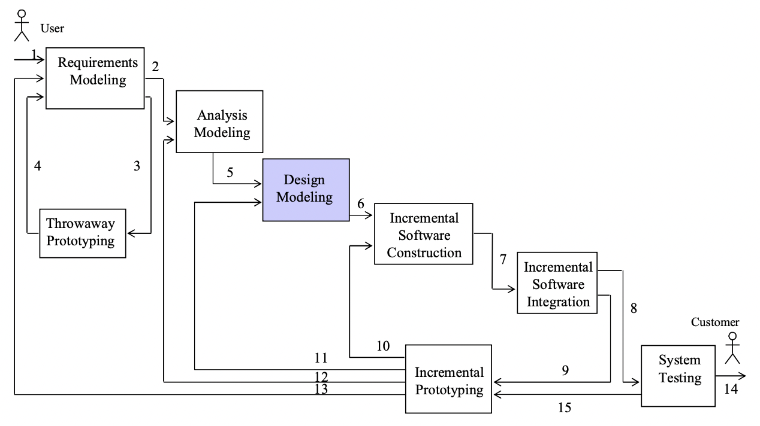
Steps in Using COMET/UML
Develop Software Requirements Model
Develop Software Analysis Mode
Develop Software Design Model
Design Overall Software Architecture (Chapter 12, 13)
Design Distributed Component-based Subsystems (Chapter 12-13,15)
Structure Subsystems into Concurrent Tasks (Chapter 18)
Design Information Hiding Classes (Chapter 14)
Design relational database (Chapter 15)

Slide 5
Relational Database Design
1. Objective: Map static model to relational database
2. Each entity class from static model that needs to be stored in relational database:
Entity class maps to one (or more) relation(s) (table)
Attributes mapped to columns of table
Each object instance maps to a row of table
3. Relational Database Design:
Primary keys
Foreign keys for associations
Association classes
Aggregation/Composition Hierarchy
Generalization/Specialization hierarchy

Slide 6
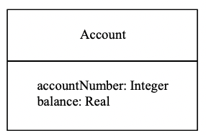

Entity Classes and Relational Tables
Account entity class
02
3
Account relational table

Slide 7
Primary Keys
1. Each relation must have a primary key
2. Primary Key:
Combination of one or more attributes
Uniquely locates a row in relation
E.g., Account Number is primary key of Account relation
Account (Account number, Balance) – (underline = primary key)

Slide 8
Relational Database Design Foreign Keys
1. Associations in relational databases:
Many-to-many association in static model
Maps to a relation
One-to-one and one-to-many associations
Use Foreign keys
2. Foreign key:
Primary key of one table that is embedded in another table
Represents mapping of association between relations into a table
Allows navigation between tables

Slide 9
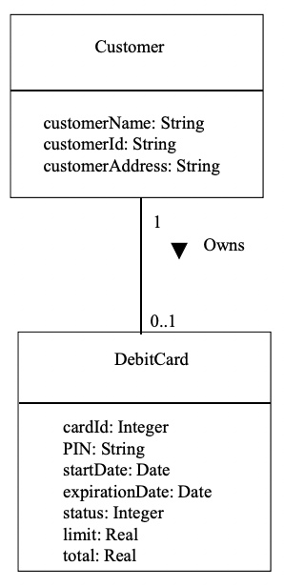
One-to-one or Zero-or-one Association
One-to-one association maps to:
Foreign key in one of relations
Zero-or-one association maps to:
Foreign key in optional relation
E.g., Customer Owns Debit Card
Static model:
Customer (Customer Name, Customer Id, Customer Address)
Debit Card (Card Id, PIN, Expiration date, Status, Limit, Total)

Slide 10
One-to-one or Zero-or-one Association
1. Relational Database Design:
Customer Id chosen as primary key of Customer
Customer (Customer Name, Customer Id, Customer Address)
Card id chosen as primary key of Debit Card relation
2. Customer Id chosen as foreign key in Debit Card
3. Represents association between Customer and Debit Card relations
4. Debit Card (Card Id, PIN, Expiration date, Status, Customer Id)
(underline = primary key, italic = foreign key)

Slide 11
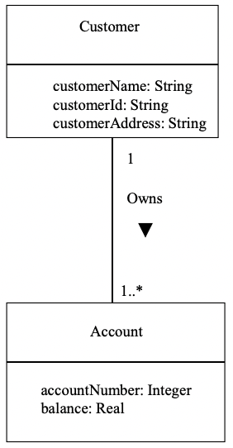
One-to-Many Association
One-to-many association maps to:
Foreign key in “many” relations
E.g., Customer Owns Account
Static model:
Customer (Customer Name, Customer Id, Customer Address)
Account (Account number, Balance)
Relational Database Design:
Primary key of “one” relation (Customer) is chosen as foreign key in “many” relation (Account)

Slide 12
One-to-Many Association
Relational Database Design:
Customer Id chosen as primary key of Customer relation
Customer (Customer Name, Customer Id, Customer Address)
Account Number is chosen as primary key of Account relation
Customer Id is foreign key in Account relation
Account (Account Number, Balance, Customer Id)

Slide 13
Static Model Association Class
Class models association between two or more classes
Usually for many Usually for many-to-many associations many associations
Association class is mapped to associative relation
Associative relation
Relation to represent association between two or more relations
Primary key of associative relation
Concatenated key
Formed from primary key of each relation that participates in association

Slide 14
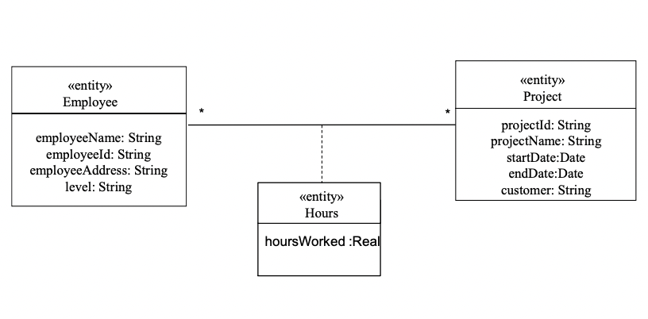
Static Model Association Class
E.g., Hours association class:
Represents association between Project and Employee classes
Mapped to Associative relation Hours
Static model:
Project (Project id, Project name)
Employee (Employee id, Employee name, Employee address)
Hours (Hours Worked)
Hours Worked is attribute of association

Slide 15
Relational Database Design Associative Relation
Relational Database Design
Project (Project id, Project name)
Employee (Employee id, Employee name, Employee address)
Project id and Employee id
Form concatenated primary key of Hours relation
Also foreign keys
Hours (Project id, Employee id, Hours worked)

Slide 16
Static Model Aggregation/Composition Hierarchy
Whole/part relationship
Aggregate/Composite (whole) class is mapped to relation
Each part class is mapped to relation
Primary key of composite/aggregate relation
All of primary key of component relation
1-1 aggregation
Part of primary key of component relation
1-n aggregation
Foreign key
If not needed to uniquely identify component relation

Slide 17
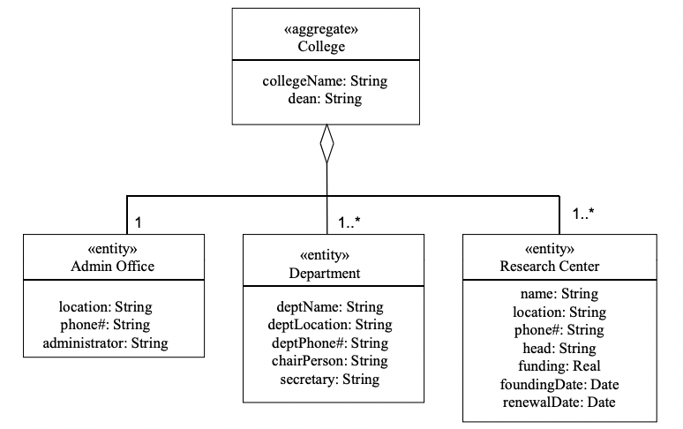
Relational Database Design Aggregation/Composition Hierarchy
E.g., Static Model:
Department IS PART OF College
Admin Office IS PART OF College
College (College name)
Admin Office (Location)
Department (Department name, Location)
Relational Database Design:
Primary key of aggregate relation = College name
College (College name)
Admin Office (College name, Location)
Department (Department name, College name, Location)

Slide 18
Static Model Generalization / Specialization Hierarchy
Three alternative mappings from Generalization / Specialization Hierarchy to relational database
Superclass & subclasses mapped to relations
Subclasses only mapped to relations
Superclass only mapped to relation

Slide 19
Relational Database Design Generalization / Specialization Hierarchy
Superclass & subclasses mapped to relations
Superclass mapped to table
Discriminator is attribute of superclass table
Each subclass mapped to table
Shared id for primary key
Same primary key in superclass and subclass tables
Clean and extensible
However, superclass / subclass navigation may be slow

Slide 20
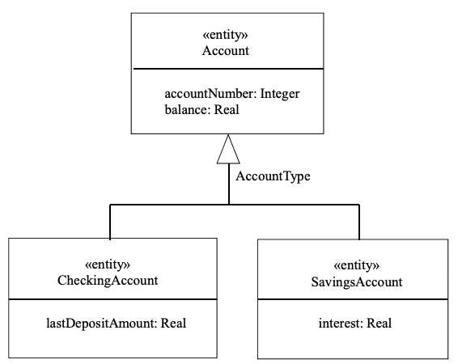
Relational Database Design Generalization / Specialization Hierarchy
Superclass & subclasses mapped to relations
E.g.: Account Generalization / Specialization Hierarchy
Static Model
Superclass: Account (Account number, Balance)
Subclass: Checking Account (Last Deposit Amount)
Subclass: Savings Account (Interest)
Relational Database Design
Account (Account number, Account Type, Balance)
Checking Account (Account Number, Last Deposit Amount)
Savings Account (Account Number, Interest)

Slide 21
Relational Database Design Generalization / Specialization Hierarchy
1. Superclass only mapped to relations
Map each subclass to relation
No superclass relation
Superclass attributes replicated for each subclass table
2. Can use if
Subclass has many attributes
Superclass has few attributes
Application knows what subclass to search

Slide 22
Relational Database Design Generalization / Specialization Hierarchy
1. Superclass only mapped to relations
2. All subclass attributes brought up to superclass table
Discriminator is attribute of superclass table
Each record in superclass table uses attributes relevant to one subclass
Other attribute values are null
3. Can use if
Superclass has many attributes
Subclass has few attributes
Only two or three subclasses

Slide 23
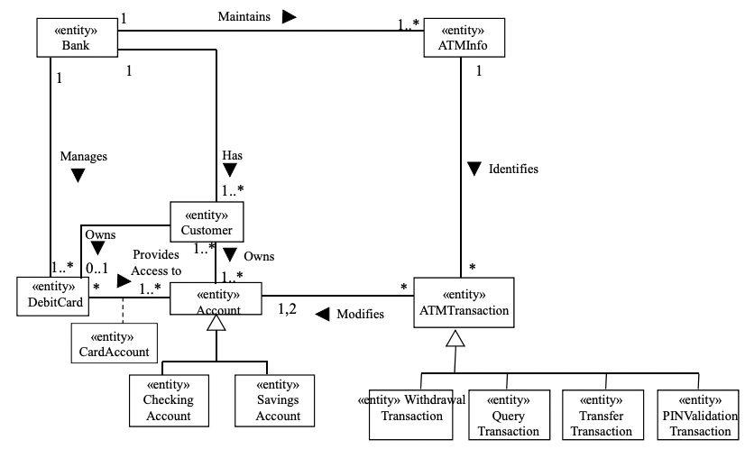
Example of Relational Database Design

Slide 24
Example of Relational Database Design
Banking System static mode
Bank Information (underline = primary key, italic = foreign key):
Bank (bankName, Bank Address, bankId)
ATM Info (bankId, ATMId, ATM Location, ATM Address) Customer (customerName, customerId, customerAddress) Debit Card (cardId, PIN, startDate, expirationDate, status, limit, total, customerId)
Checking Account (accountNumber, accountType, balance, lastDepositAmount)
Savings Account (accountNumber, accountType, balance, interest) Card Account (cardId, accountNumber)
Customer Account (customerId, accountNumber)
Assumption: Account type is determined from account number

Slide 25
Thanks!
We hope you learned something new.

